Slide 1
Temperature Controller and IV Characterizer Group Number: DD 16 Project Guide: Prof. Joseph John
Group Members
OV Shashank 14D070021
Yogesh Mahajan 14D070022
Ayush Agrawal 14D070042
Notes:
You’re watching the Electronic Design Lab video of group DD16. Our project topic is Temperature Controller and IV Characterizer and our project guide is Professor Joseph John. Our team consists of Shashank, Yogesh and Ayush. [Switch]

Slide 2
Abstract
The aim of the project was to build a wide range temperature controller using a Peltier Cooler which provides cooling and corresponding heating through the thermoelectric effect
The setup is to be used to plot the IV Characteristics of two terminal devices at various temperatures for the purpose of validation of the temperature control.
Along with the temperature controller, the IV Characteriser was also designed as part of the project.
Notes:
Our project aims at building a wide range temperature controller using the peltier cooler which works on the thermoelectric effect. The Peltier cooler is a planar device which heats one of its sides and cools the other, and the side which gets cooled depends on the current flow direction making it suitable for both heating and cooling. To validate out temperature controller, we have also built an IV Characteriser for 2 terminal devices like diodes at various temperatures using the Peltier Cooler setup. [Switch]

Slide 3
Motivation
Not an easy way to quickly characterize a devices’ characteristic at various temperatures
Reduce the manual effort by designing an automated system
Learn about the Peltier Cooler
Learn precise low power system design for the IV Characteriser
Learn coding for new microprocessors and GUI Design
Notes:
The main motivation behind this project is to combine two systems in a way which proves to be useful in characterization of critical device parameters whose variation with temperature is important. Such devices are pretty common in the semiconductor industry and they are to be built to provide reliable results at a wide range of temperatures often. There have been temperatures controlled for devices like lasers and IV Characterisers also exist but this project proposes a unique combined system.
Apart from the utility the project also serves as a way to learn about the Peltier Cooler and its high current control circuit along with a more precise low voltage current and voltage measurement circuit and also aspects of new microprocessor coding and user friendly GUI Design. [Switch]

Slide 4
Sub-Systems
Peltier Temperature Controller
IV Characteriser
Power Supply Circuit
Microcontroller (TIVA-C Launchpad) and Python GUI
Notes:
The basic sub-systems in our project are the Peltier Temperature Controller, the IV Characteriser, the power supply circuit which is driven by two SMPSs to generate the dual supply required for the Op-Amps and the Central Control Unit consisting of the microcontroller TivaC which is tethered to the GUI using a USB connection. Now we go on to look at a brief glimpse at the implementation of each of the blocks. [Switch]

Slide 5
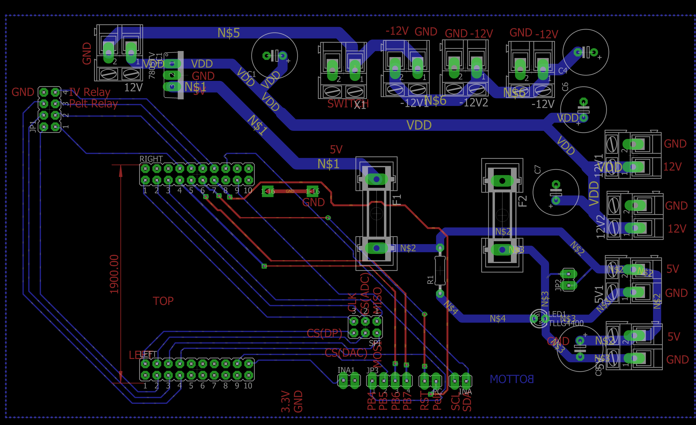
Power Supply Circuit and TIVA Breakout
Notes:
On the screen is the Eagle Board Layout of the Power Supply. The board mainly function as a receiver and distributer of +-12V supply. It also produces 5V as required by the Relays and certain low power analog devices with the use of the linear regulator. It additionally functions as a breakout board for the TivaC to make easy the multitude of connections to it. [Switch]

Slide 6
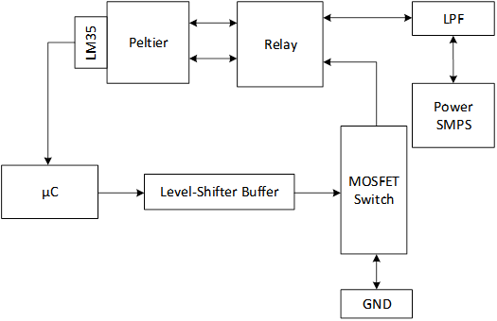
Peltier Temperature Controller
Notes:
This is a basic block diagram of the Temperature Controller. Temperature control is achieved through voltage control with the help of a power MOSFET and switching of polarity is achieved by the Relay. Initially the plan was to use PWM and PID control but because of noise in the 5V supply caused due to the high switching currents flowing through the Relay which hampered the measurement by the DAC, we switched to a Bang-Bang or On-Off controller using the same circuit. It gave a higher error but it was tolerable for our purpose. [Switch]

Slide 7
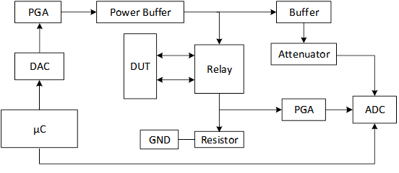
IV Characteriser
Notes:
On the screen is the block diagram for the IV Characteriser. The circuit is quite simple as it used a DAC to supply the voltage and a relay to provide the polarity switching, and the voltage and current is measured using ADCs. The various amplification and attenuation stages were necessary to increase the range and precision of the system. [Switch]

Slide 8
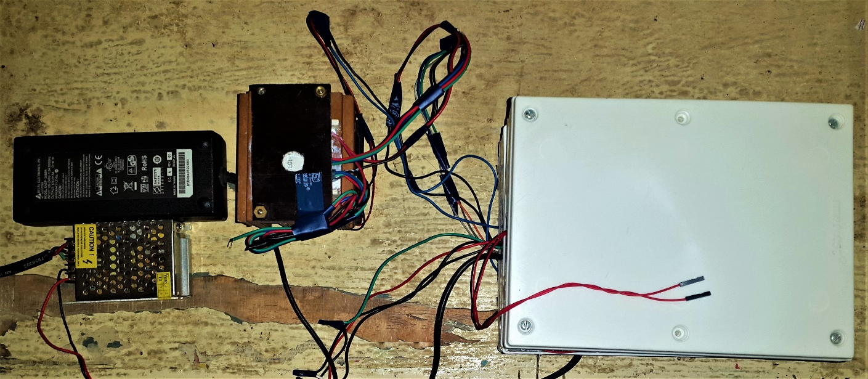
Peltier Setup
Power Supply SMPS
DUT Electrical Slot
DUT Temperature Slot
Notes:
This is the final demonstration implementation of our project. The various systems have been labelled. [Pause] The stack of white boxes houses the circuitry while the Peltier Cooler setup and the power source SMPS are placed on the exterior. [Switch]

Slide 9
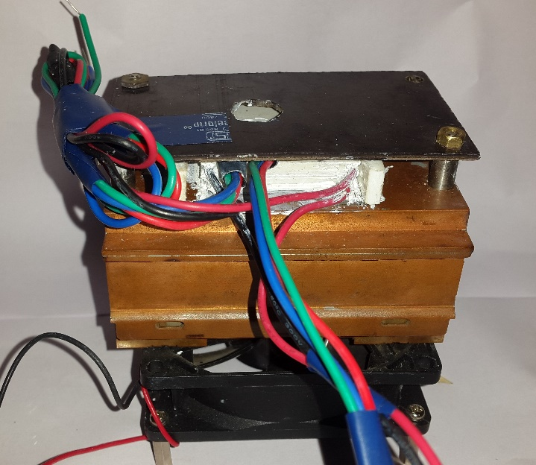
Notes:
Here is closer look at the Peltier Cooler setup. We have used two Peltier Coolers in series stacked on top on one another to reach sub-zero temperatures. The setup features a large heat sink along with a fan for the same purpose why removing the heat from the other side of the cooler effectively. An extra LM35 sensor has been placed for backup.

Slide 10
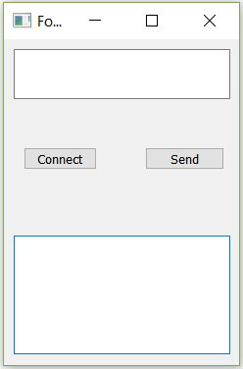
Graphical Interface on the PC
Notes:
The graphical interface used for the demonstration purpose is a simple one. As on the screen, we see that there are two boxes in the UI. The top one is used for user input while the bottom one acts as a textual output. Temperature set point is changed by entering a value between 0 to 110 which has been linearly mapped to -10 to 100 degrees. And any value beyond that begins the IV Characterisation. The stabilisation of temperature is up to the discretion of the user which can be made out using the temperature graph as plotted by the UI. Once all the IV data has been obtained the UI plots the IV Plot.

Slide 11
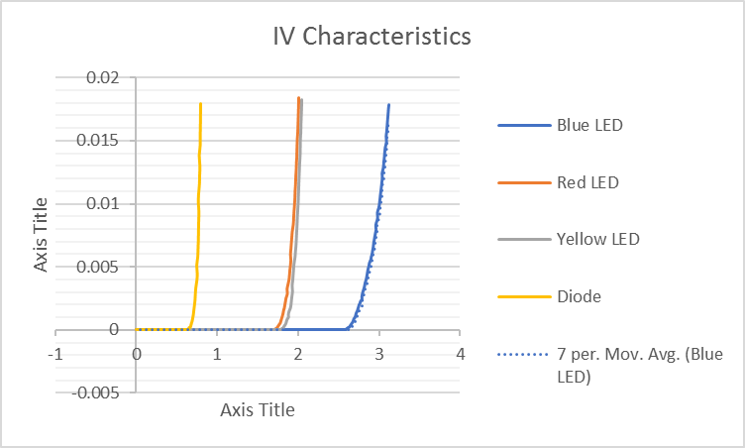
Testing Results
Peltier Temperatures were stabilised in the range of -5 degrees to 100 degrees
Temperatures around room temperatures showed more oscillations
IV Characterisation was completed and the following are the results
Notes:
Now we discuss the testing results. We were able to achieve a stable range of -5 to 100 degrees and also the IV characterisation up to 20 mA was performed. The results of IV characterisation of various LEDs and diodes can be seen in the image. [Switch]

Slide 12
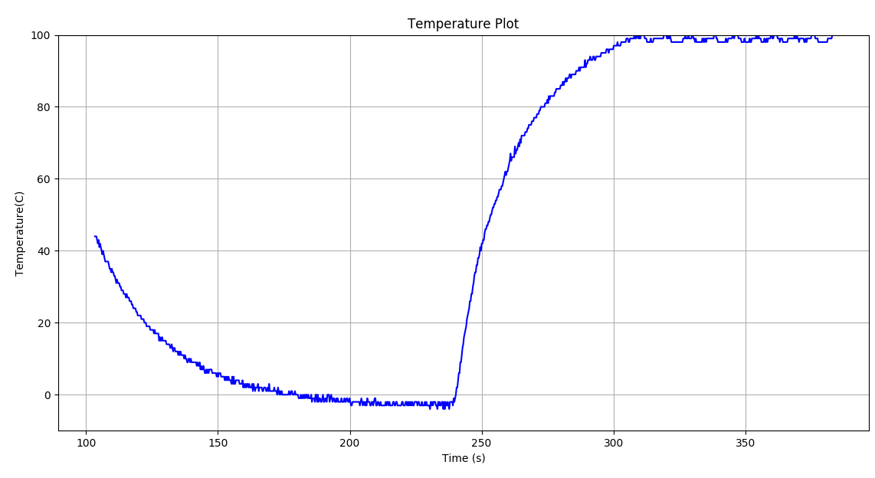
Notes:
This is plot of the temperature as plotted by the GUI. Stabilisation at sub-zero temperatures and 100 degrees can be clearly seen.

Slide 13
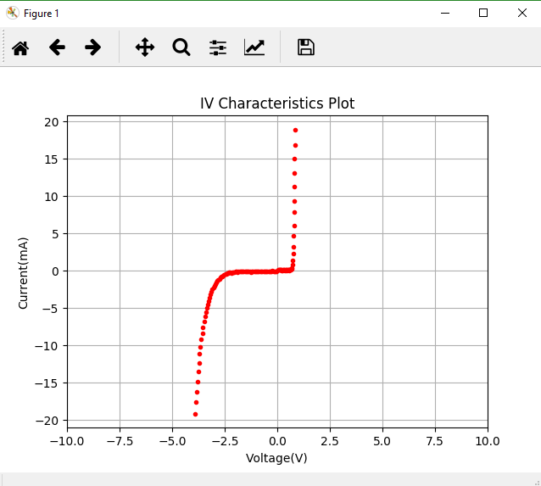
Notes:
This is an image of the IV Characteristics of a Zener Diode as plotted by the UI. Now we move on to look at some videos of our system in action. [Switch]

Slide 14
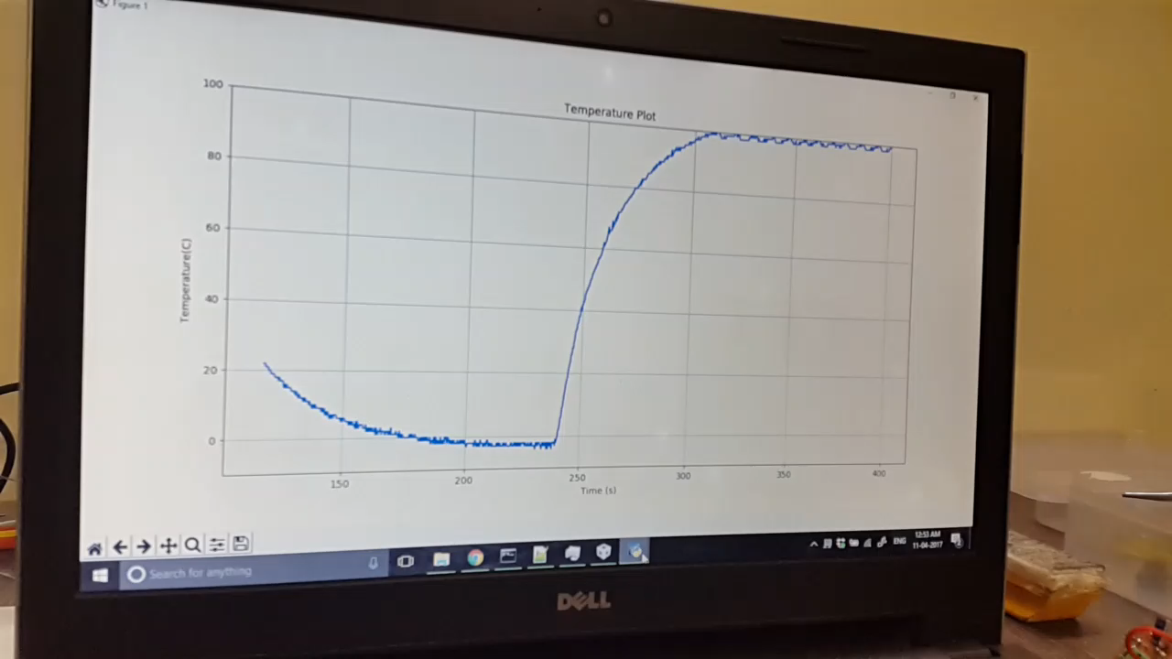
Notes:
This clip shows the response of the system as the set point is changed from 100 degrees to -10 degrees using the UI. [Pause] Clearly the drop in the temperature in response to the input can be observed. [Switch]

Slide 15
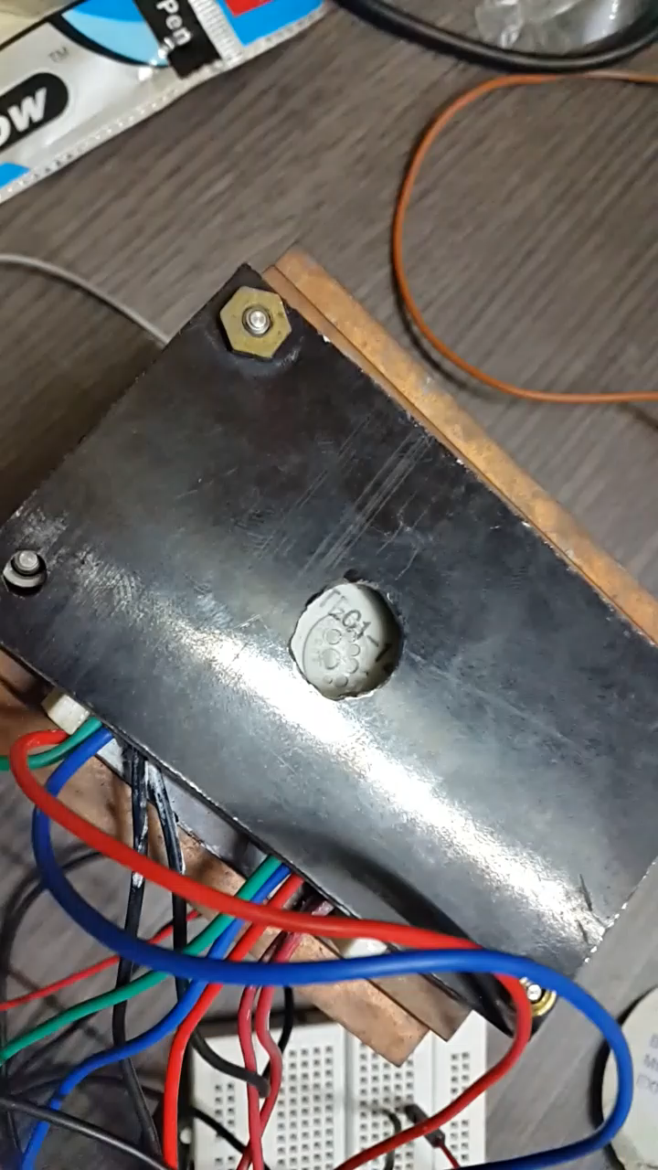
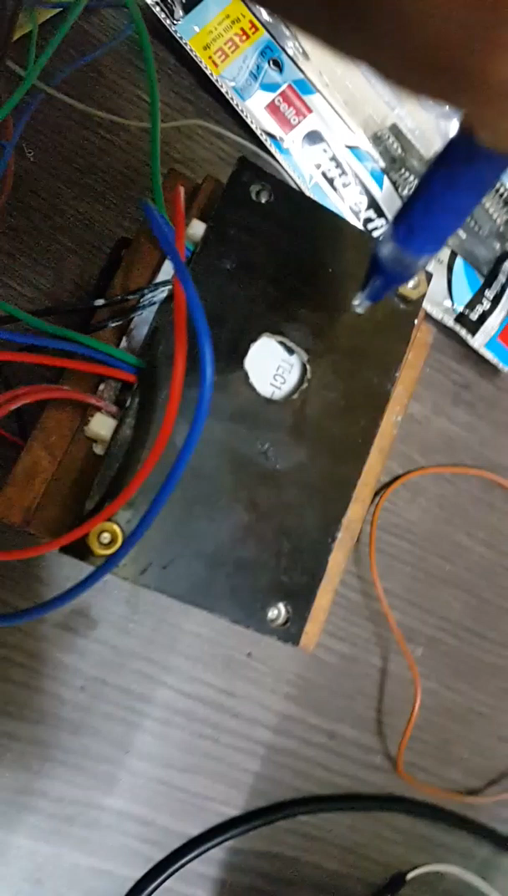
Notes:
Here first we look at water boiling on the Peltier Cooler [Pause] And here we have water being frozen on the same surface [Pause] [Switch]

Slide 16
Future Scope
Performing the small signal analysis of the two-terminal device
Extend support to multi-terminal devices by applying bias to the other terminals and performing the IV Characteristics across the remaining terminals
Temperature Control of the Peltier Cooler can be made more precise by using the double control loop
More dynamic changes can be introduced in the IV Characteristics to make the control more robust, immune to errors and fine grained to get high standard results.
Notes:
Our project is in no way complete and perfect. Several improvements are proposed as follows. There also exist AC parameters of devices whose variation with temperature might be important and to capture that, the small signal analysis of a two terminal device can also be performed. Also support can be extended to multiterminal devices like MOSFETs or BJTs. Improvements can also be made in terms of the circuits which may allow for PWM control or a truly current controlled peltier controller which could provide lower error. More fine tuning can also be performed for the IV Characterisation circuit. [Switch]

Slide 17
Thank You
Notes:
With this we end the video. Thank You for watching! [End]

